Slide 1

LET US TALK THROUGH GESTURE VOCALIZER
Under the guidance of
Prof. Prasad A.M.
Assistant Professor
Computer Science Department
Dayananda Sagar College of Engineering.
Team Members
1. Thejaswini S Acharya
2. Vaibhavi V Badiger
3. Yashaswini M
4. Sulaksha Sayeesh Padti
Department of Computer Science & Engineering, DSCE

Slide 2
INTRODUCTION TO THE PROBLEM:
Over 1 billion people are estimated to experience disability among those 430 million are deaf and 1 million are dumb.
Vocal Communication is a way to convey our thoughts, messages, and information. However, each of us is not gifted to be able to share our thoughts in verbal mode with others due to some physical disabilities
Thus, there is a need of building up a device that can interpret the gestures into text and speech.
Department of Computer Science & Engineering, DSCE

Slide 3
Cost Analysis
Components | Cost(Rs)
Arduino Nano | 500
Copper Sheets | 20
Accelerometer | 650
Bluetooth module | 300
Voice module and speaker | 500
Others | 500
Total | 2470
Department of Computer Science & Engineering, DSCE

Slide 4
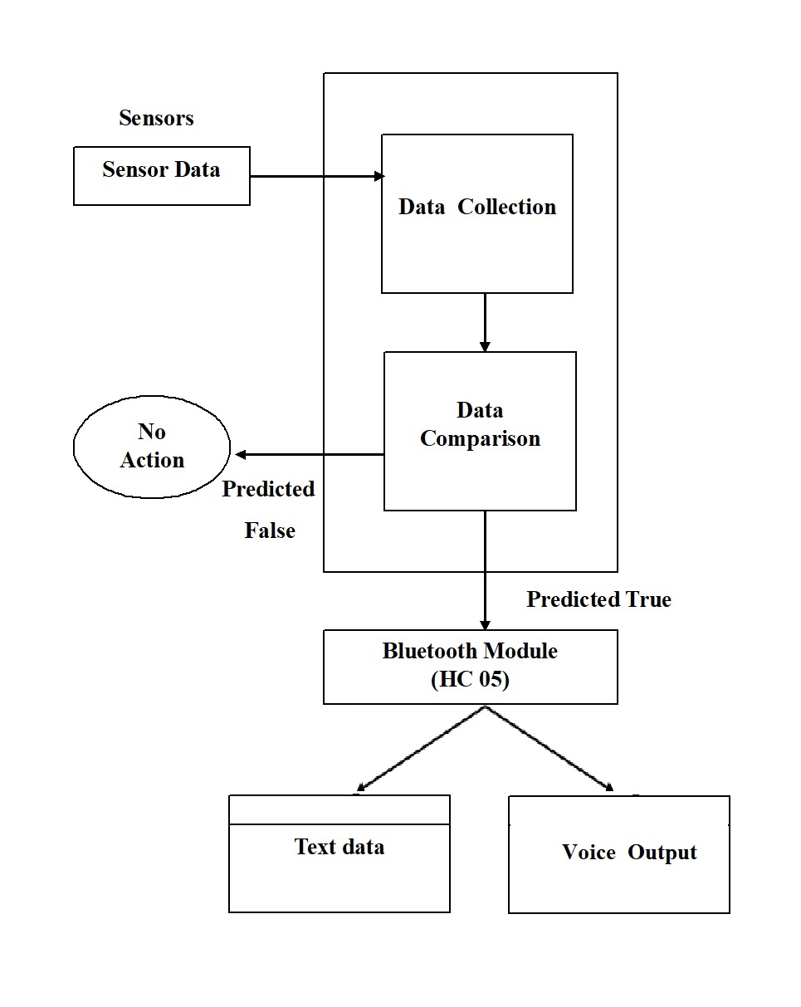
SYSTEM DIAGRAM / ARCHITECTURE:
Department of Computer Science & Engineering, DSCE

Slide 5
Methodology:
Each finger of the left hand is mounted with copper sheets. Four of them are used to give input, fifth one is connected to the ground pin of the nano board.
Accelerometer and Bluetooth BLE module is connected to the Arduino board.
From copper sheets and accelerometers, both static and dynamic gestures can be identified.
When the user does the proper gesture, the corresponding string data is generated in themicrocontroller.
That string can be displayed in the Android Bluetooth application as well as the voice output is generated in the Android application only.
The application which we have used will pronounce the text displayed on the phone when the correct gesture is performed.
Department of Computer Science & Engineering, DSCE

Slide 6
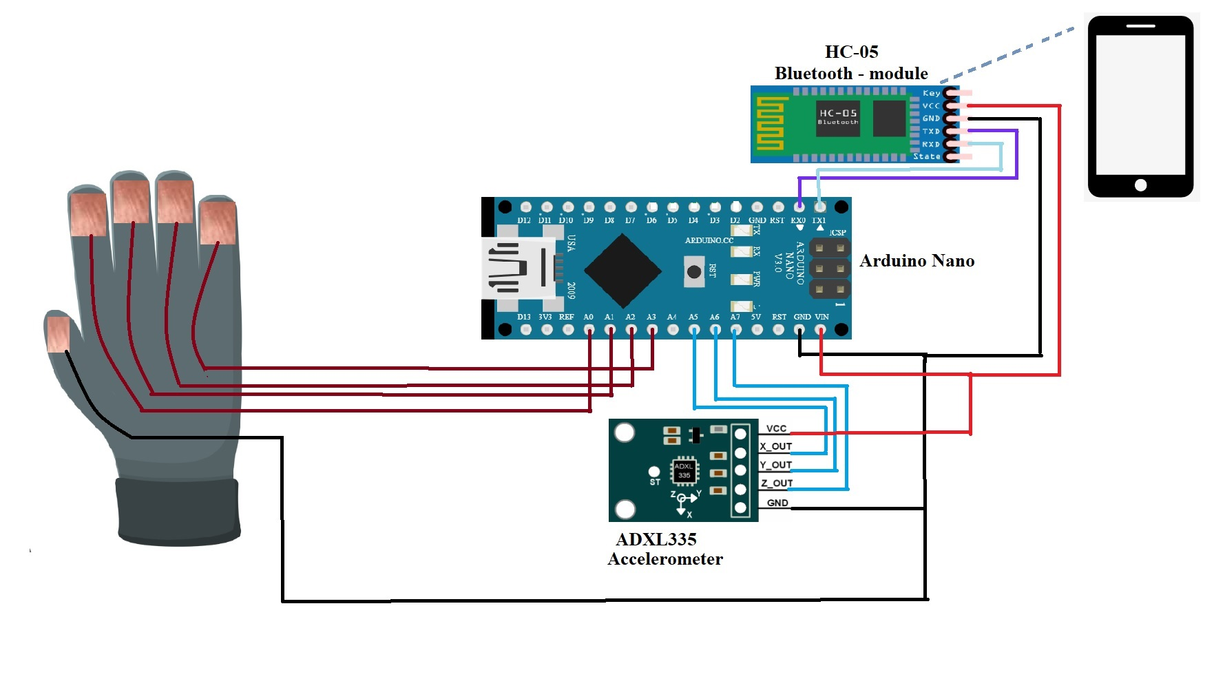
0
CIRCUIT DIAGRAM:

Slide 7
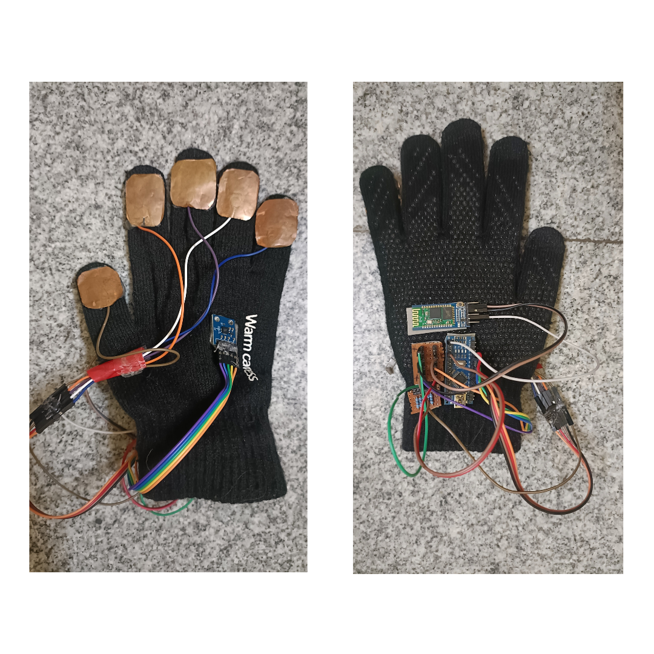
0
Proposed System:

Slide 8
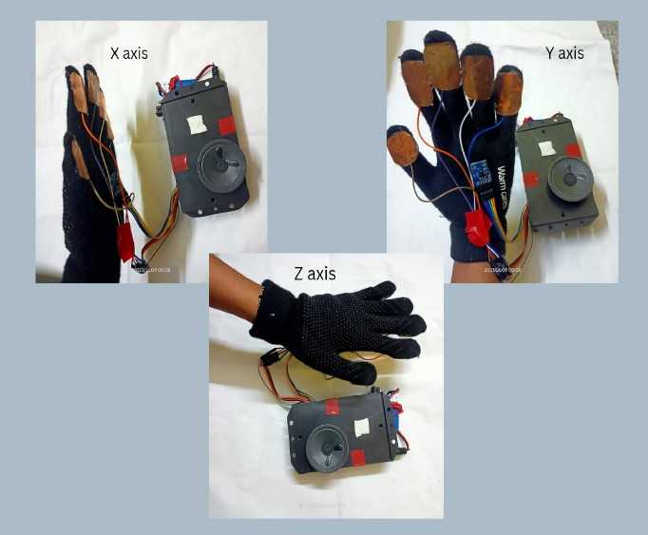
0
Result:

Slide 9
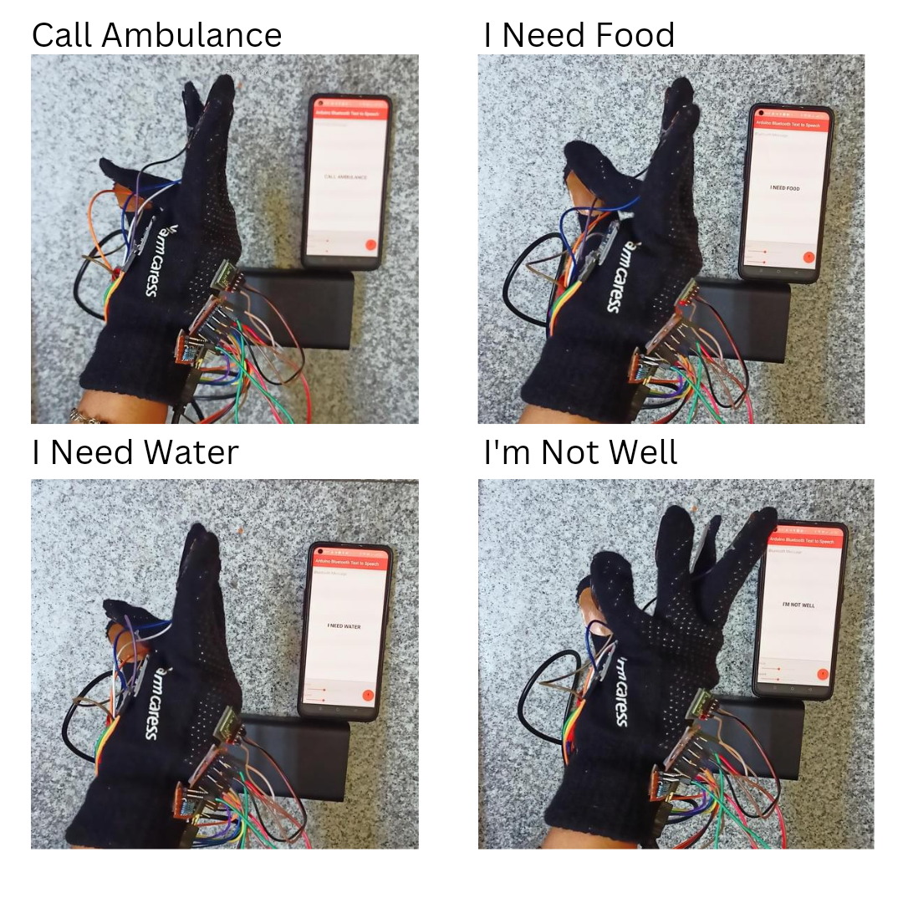
0
Result:

Slide 10
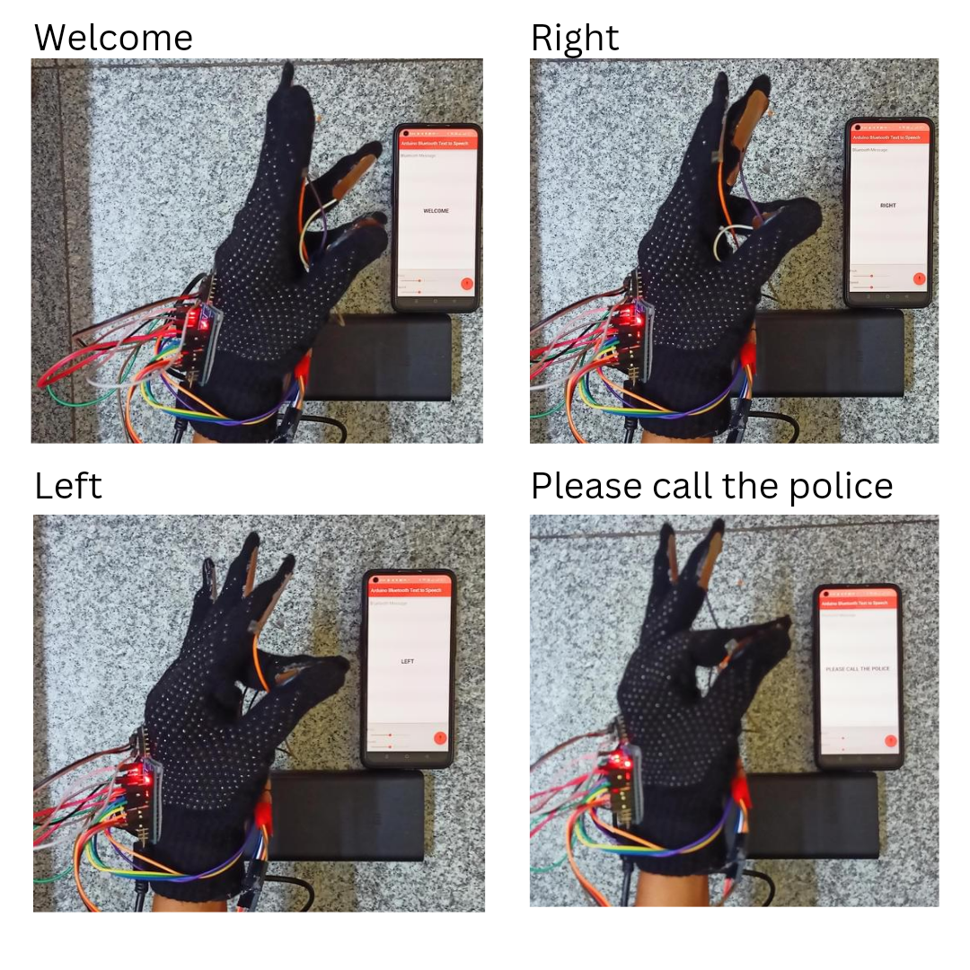
0
Result:

Slide 11
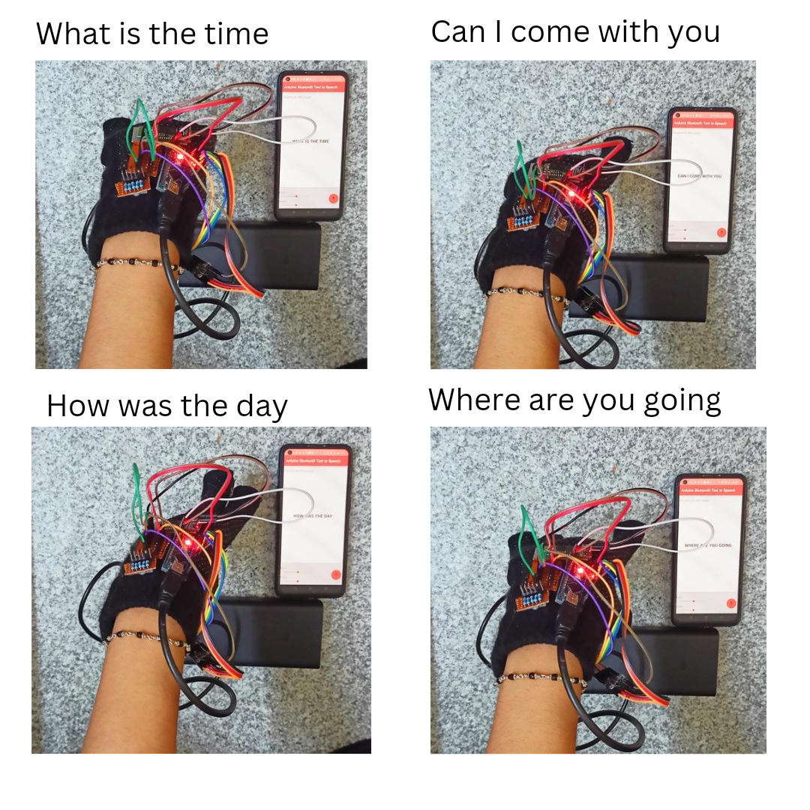
0
Result:

Slide 12
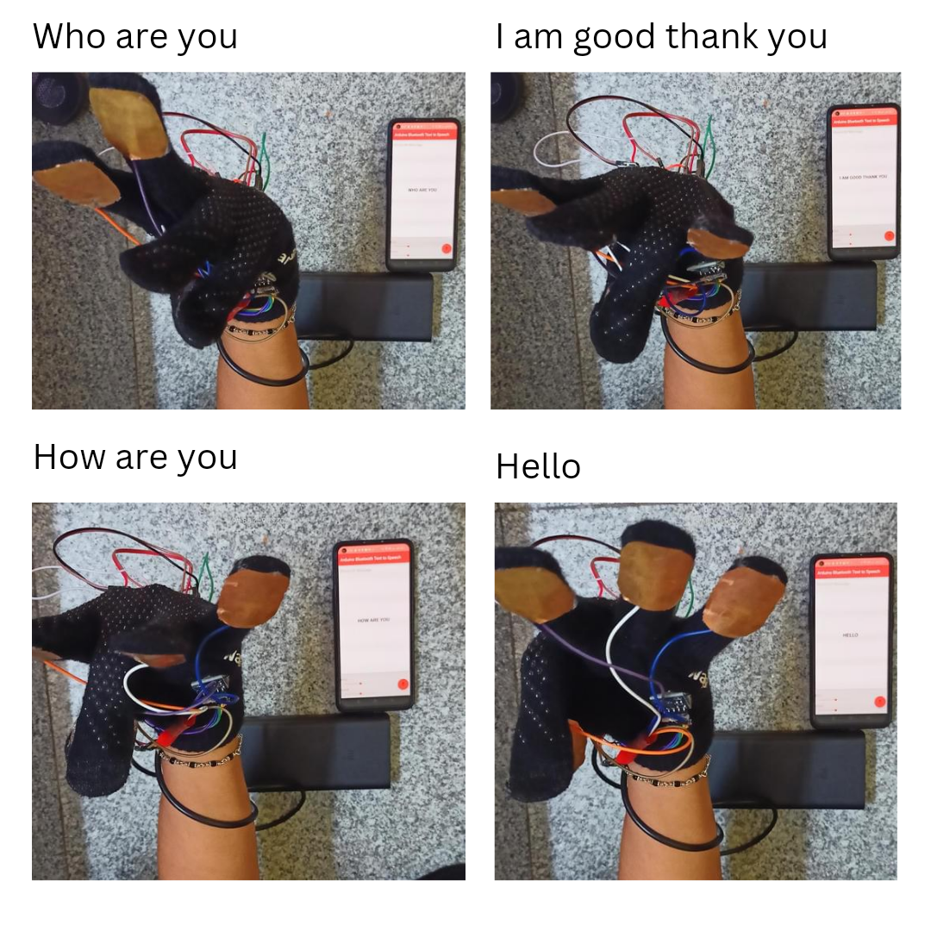
0
Result:

Slide 13
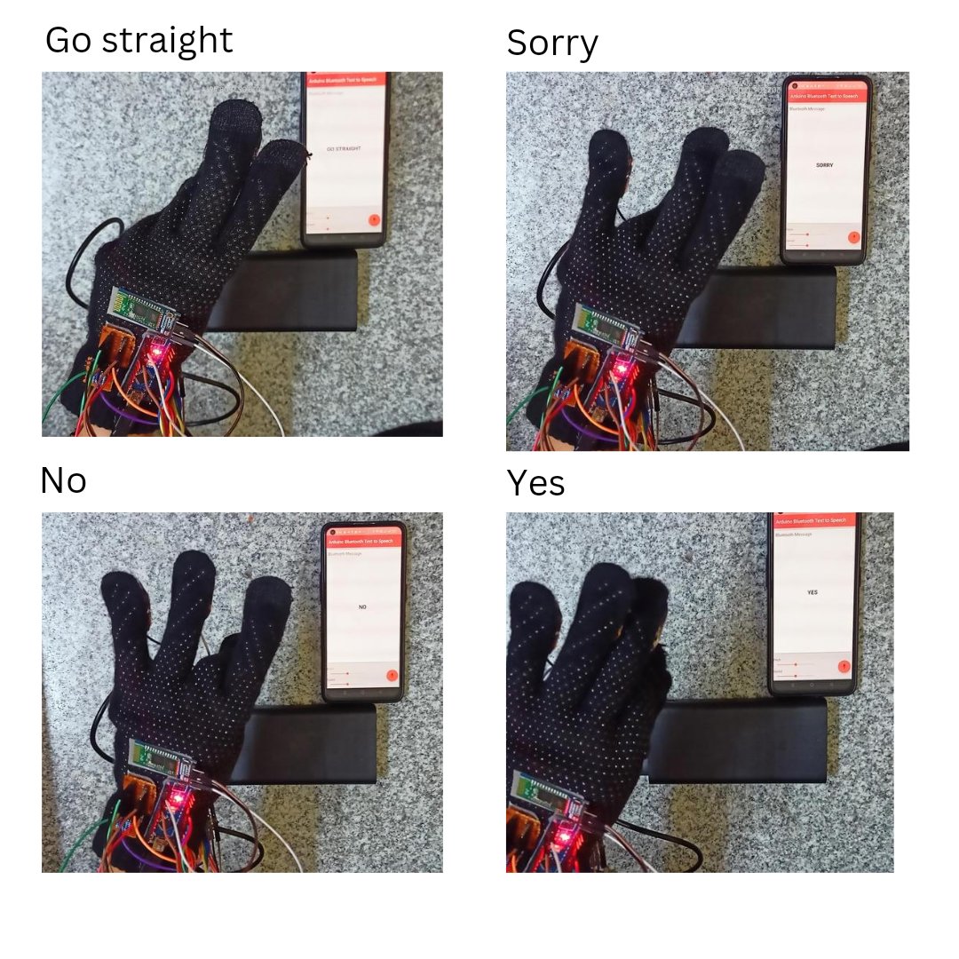
0
Result:

Slide 14
THANK YOU!
Department of Computer Science & Engineering, DSCE

